Slide 1
Exploring the Rich Tapestry of Israeli Communities
7 Unique Cultural Experiences

Slide 2
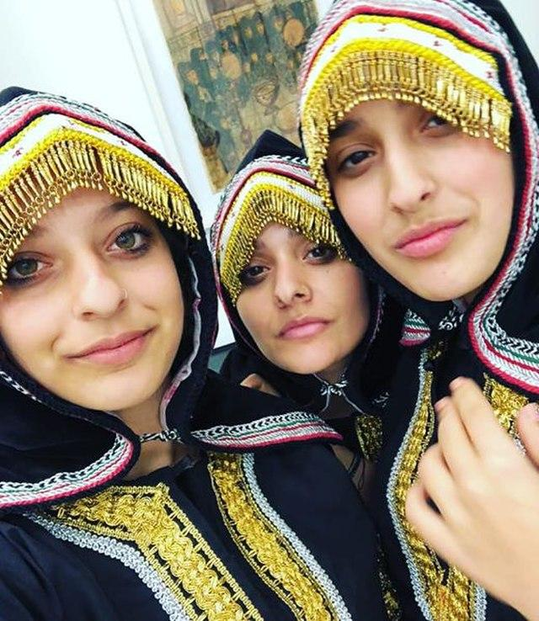
Yemenite
Discover the ancient traditions of Yemenite Jewry
Explore authentic artifacts and historical exhibits
Experience traditional Yemenite Jewish culture and customs
Learn about the mass immigration to Israel (Operation Magic Carpet)
Enjoy traditional music, crafts, and culinary heritage

Slide 3
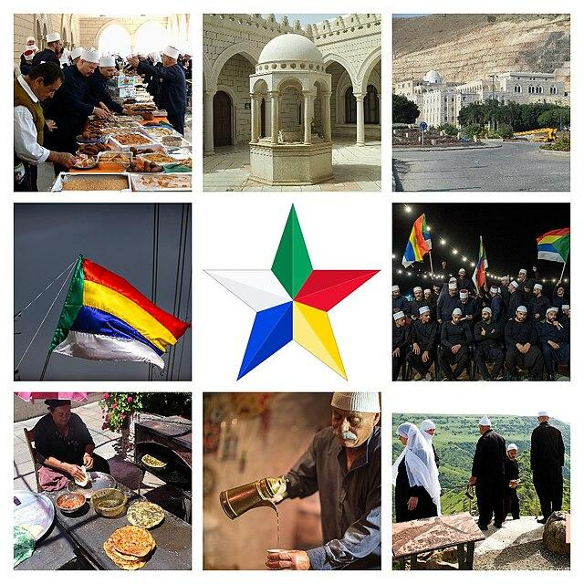
Druze
Immerse yourself in the unique Druze culture
Visit a traditional Druze village and meet local families
Learn about Druze faith, values, and way of life
Taste authentic Druze cuisine and hospitality
Understand the special relationship between Druze and Israeli society

Slide 4
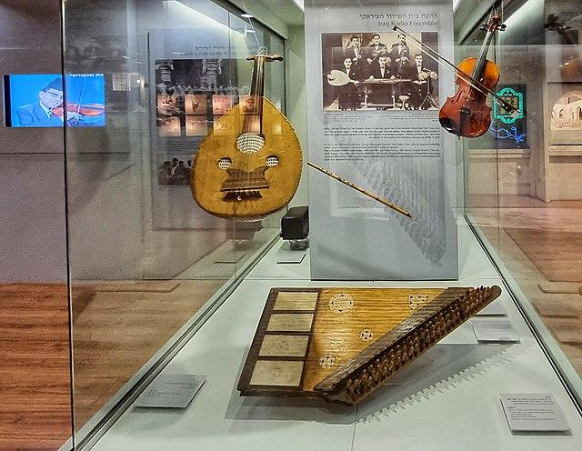
Iraqi
Explore the ancient heritage of Babylonian Jewry
Discover the rich cultural legacy of Iraqi Jews
View historical documents and community artifacts
Learn about the vibrant Jewish community that flourished in Iraq
Experience the music, poetry, and traditions of Iraqi Jews

Slide 5
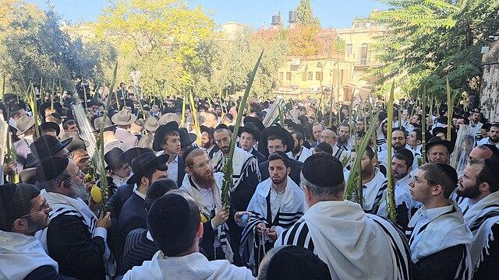
Hasidic
Experience Shabbat with various Hasidic groups
Tour the historic neighborhoods of Mea Shearim and Geula
Learn about different Hasidic dynasties and their traditions
Attend special Shabbat prayers and celebrations
Understand the lifestyle and spiritual practices of Hasidic Judaism

Slide 6
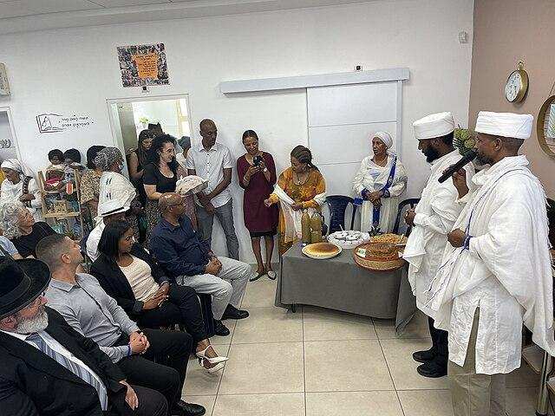
Ethiopian
Discover the ancient traditions of Beta Israel (Ethiopian Jews)
Learn about the dramatic airlifts: Operation Moses and Solomon
Experience traditional Ethiopian Jewish ceremonies and customs
Taste authentic Ethiopian cuisine and coffee ceremony
Understand the integration journey and cultural preservation
Meet community members and hear personal immigration stories

Slide 7
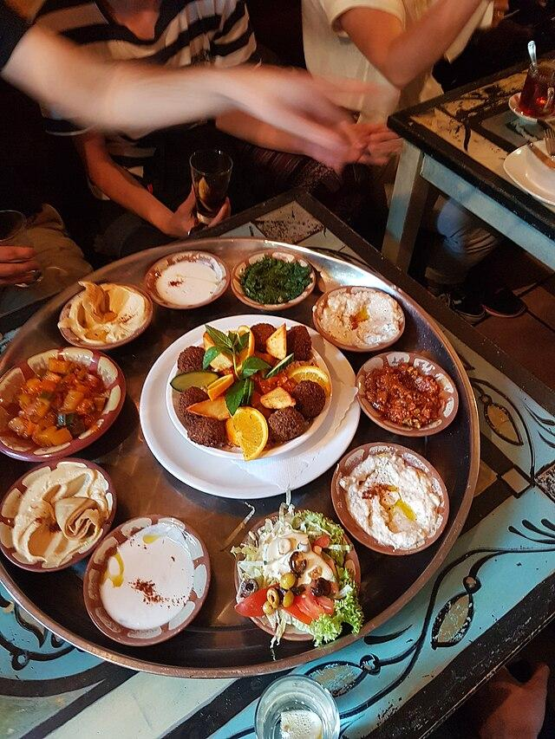
Moroccan
Explore the rich legacy of North African Jewry
Visit sites significant to Moroccan Jewish culture
Learn about the golden age of Moroccan Judaism
Experience traditional Moroccan Jewish music and poetry
Discover the unique customs of Mimouna and other celebrations
Taste traditional Moroccan Jewish delicacies

Slide 8
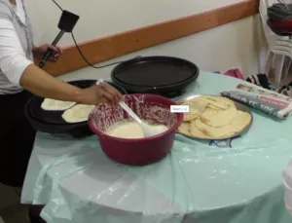
Cochin
Uncover the ancient community of Indian Jews from Kerala
Learn about 2,000 years of Jewish life in India
Explore unique Cochin Jewish traditions and synagogue customs
Experience the blend of Indian and Jewish cultures
Discover traditional Cochin Jewish songs and Malayalam prayers
Meet descendants and learn about their journey to Israel

Slide 9
General
Duration: 7 sessions over several month
Transportation provided between locations
Expert guides specializing in each community
Small group sizes for intimate experiences
Kosher meals
Join us on this unforgettable journey!

